Slide 1
MyParker
Delegated Administration Training
July 20, 2020

Slide 2
What is delegated administration?
Provides the ability for Parker customers to manage MyParker users within their organization
Add, modify, and delete
Requires “Administrator” role to access
Location specific

Slide 3
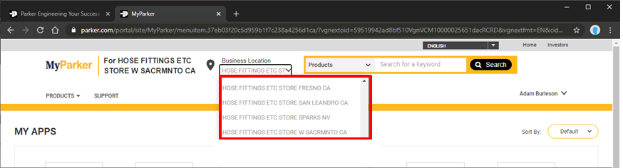
Delegated Administration
Users can be assigned multiple locations
Role is defined at each location – Either “User” or “Administrator”
“Administrators” have access to delegated administration

Slide 4
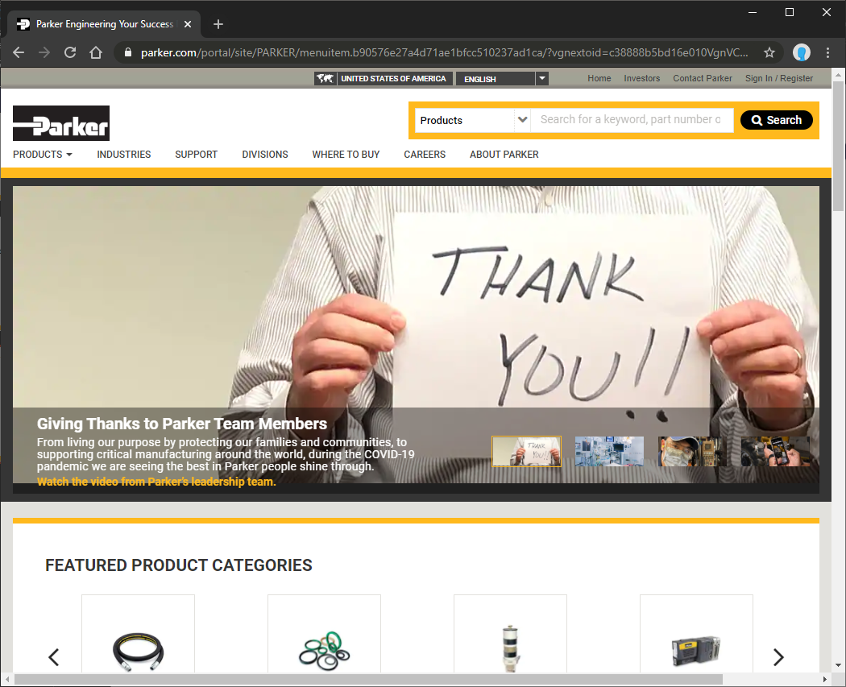
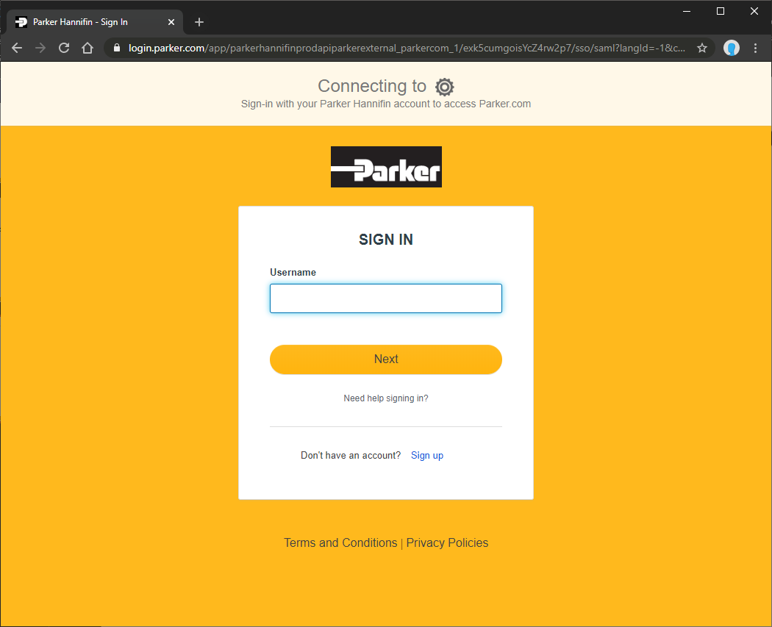
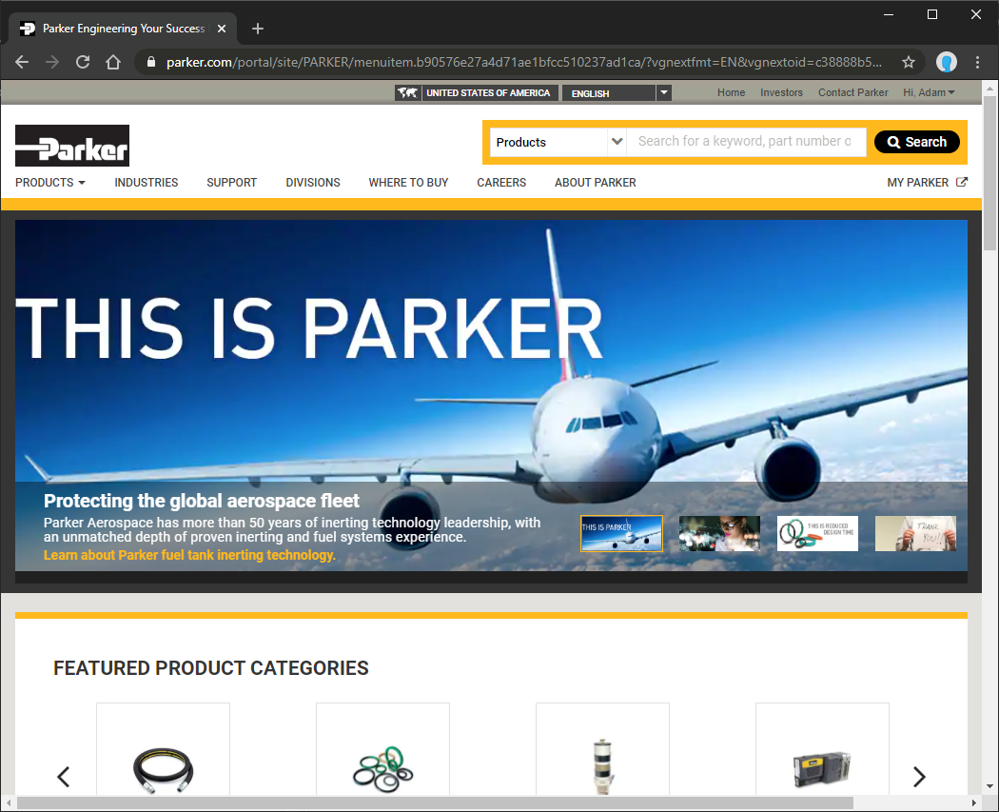
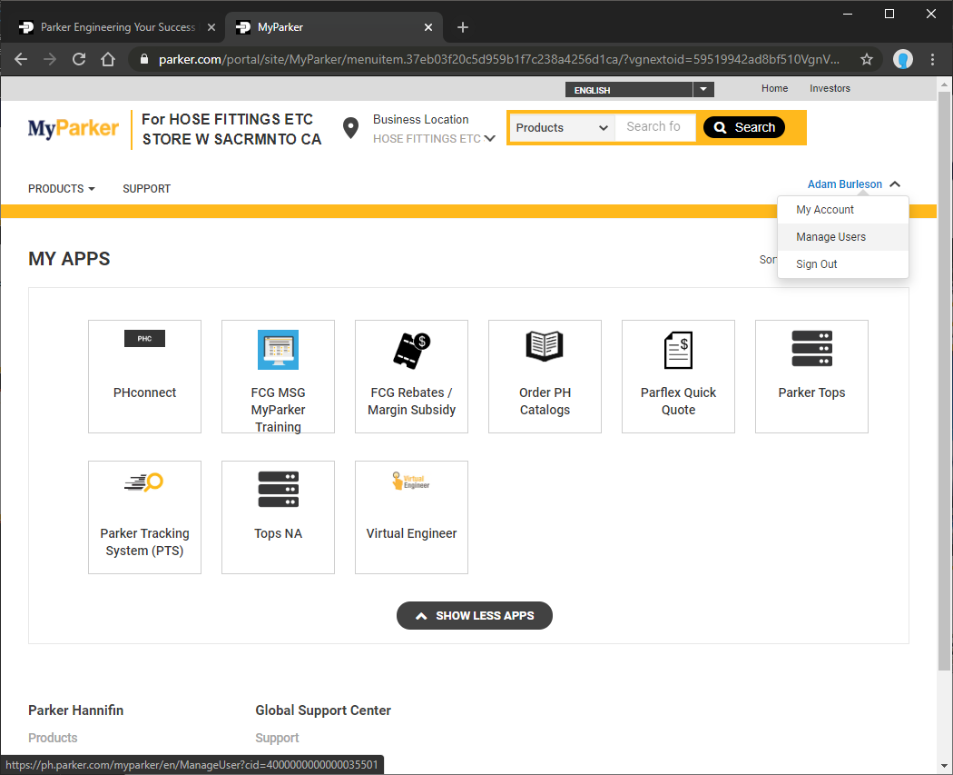
How to access delegated administration
1
2
Go to Parker.com and click Sign In
Sign in
3
4
Select the location to manage and click Manage Users
Click the MyParker link

Slide 5
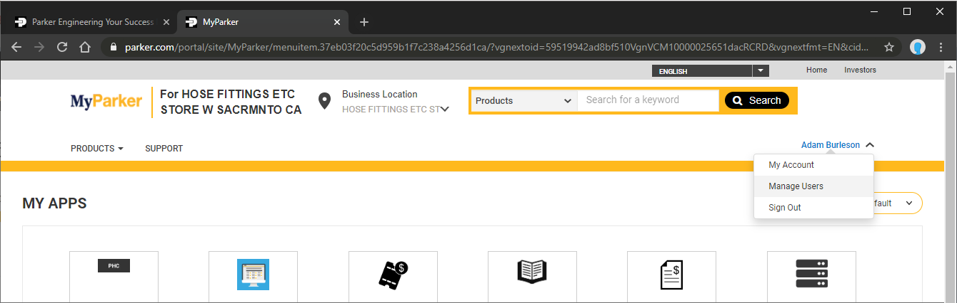
How to access delegated administration

Slide 6
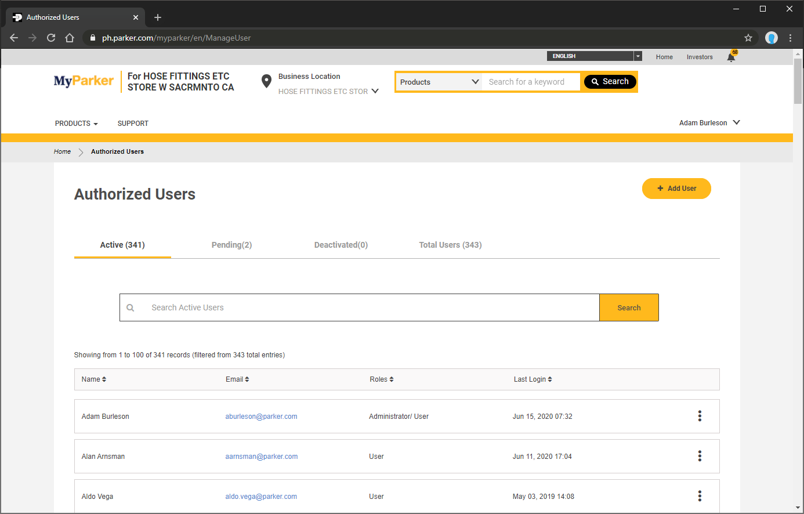
Delegated Administration
Shows active users within the selected location
Deactivated shows users that have been disabled and no longer have access to the location
Pending shows users who have not completed their account migration or activation
Total Users shows all users across all three statues

Slide 7
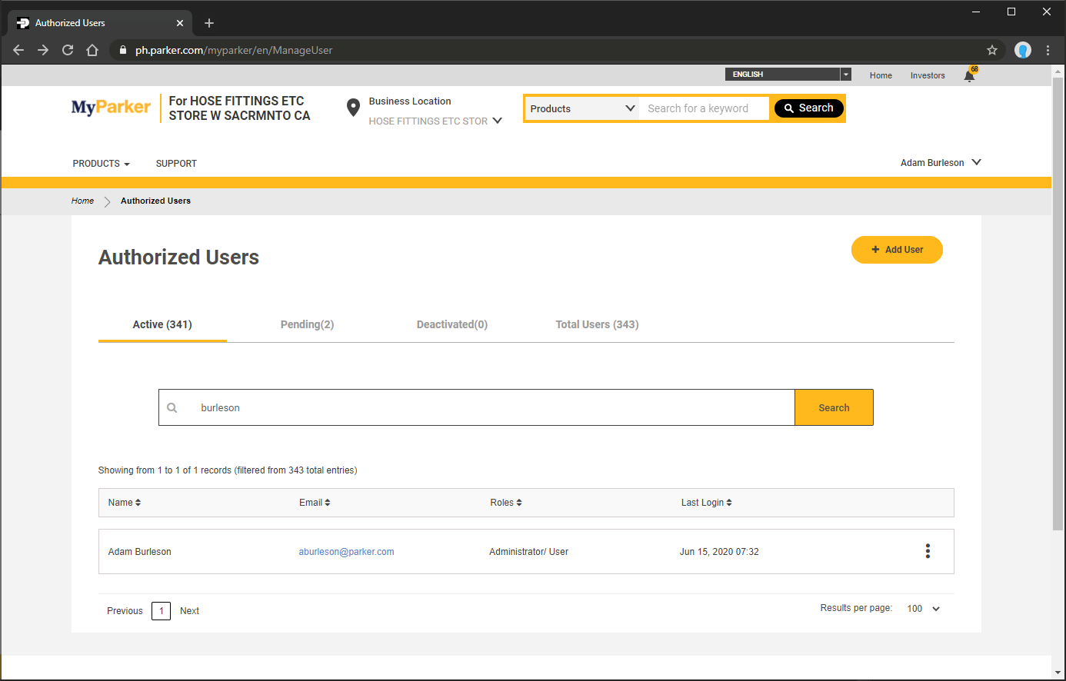
Searching
Searches results within the selected tab

Slide 8
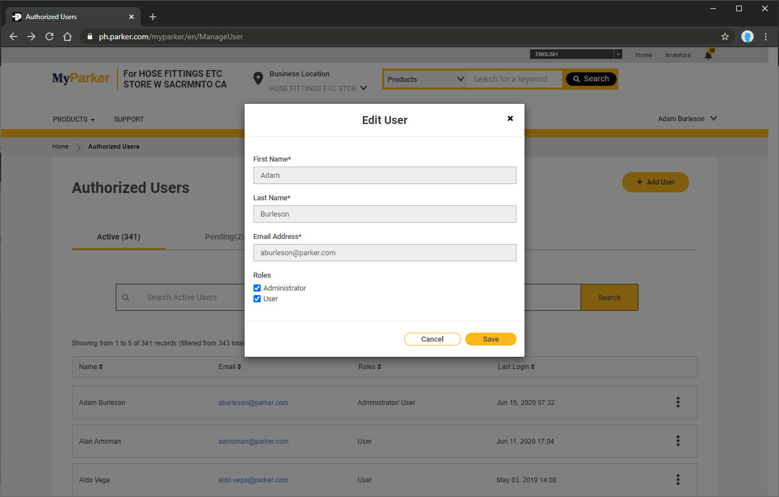
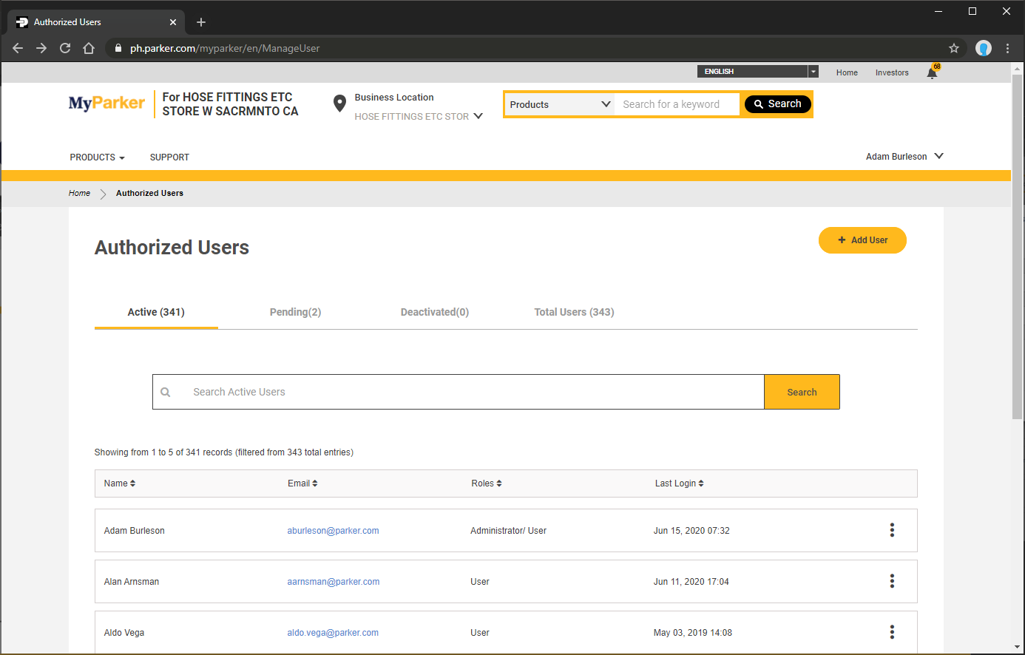
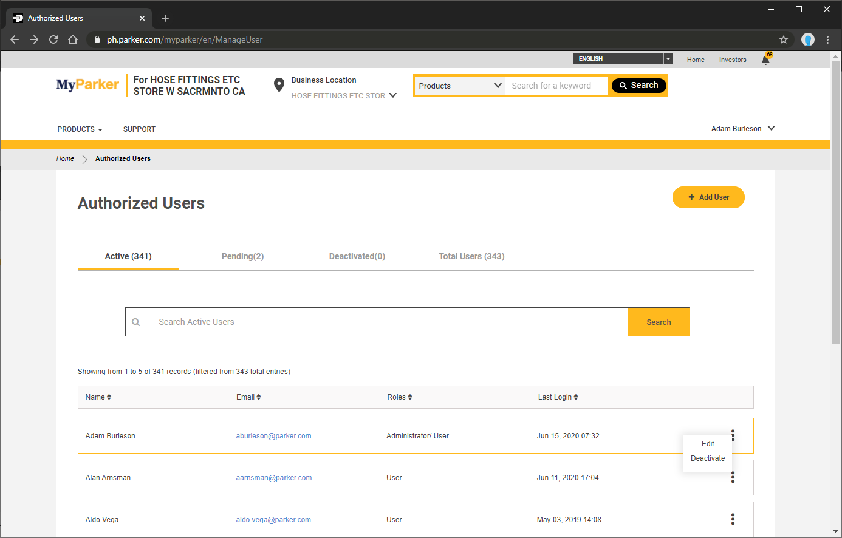
Edit

Slide 9
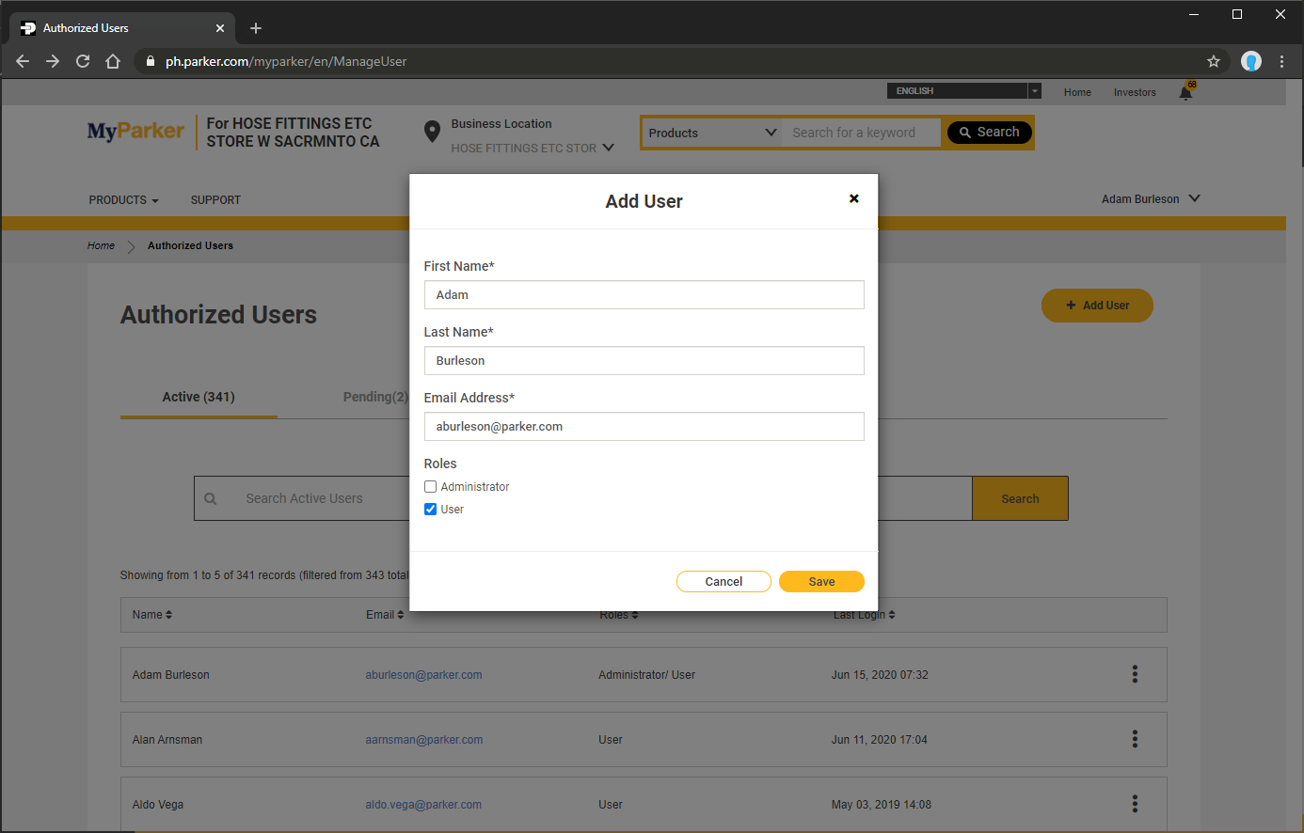
Add User
Select role for the user

Slide 10
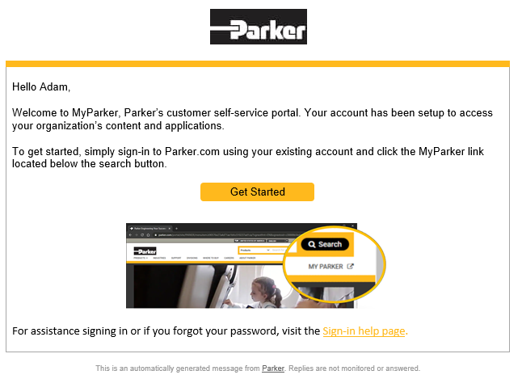
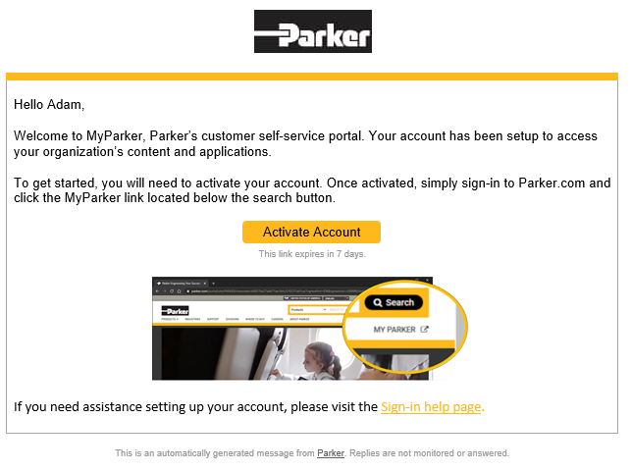
Email Notification

Slide 11
FAQ
For missing locations, incorrect or outdated locations, please submit a help desk ticket to servicedeskglobal@parker.com

Slide 12
Questions?

